Slide 1
Graphs
EQ: How do I interpret information presented in graphs?

Slide 2
Learning Outcomes
Dot Points
1.4.1 interpret information presented in graphs, such as: conversion graphs, line graphs, step graphs, column graphs and picture graphs
Contexts
Understand the data that is presented in graphs in a range of situations

Slide 3
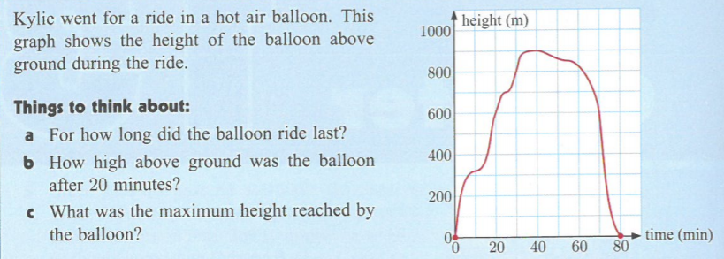
Opening Problem- Class Discussion

Slide 4
24
7
30
Topic: Graphs
Date
EQ: How do I interpret information presented in graphs?
Tables and graphs are used to efficiently present information in news articles, advertising, business, sports and many other situations
It is important that we are able to correctly interpret what these tables and graphs are telling us.
Think-Pair- Share : Define “interpret”

Slide 5
24
7
30
Topic: Graphs
Date
EQ: How do I interpret information presented in graphs?
Class discussion on how to read and interpret graphs:
1. Identify what the graph represents- title, x- and y- axes
2. Check the scale for each graph element.
3. Locate the graph element you want information on.
Notes:
1. Identify what the graph represents.
Most graphs will have a clearly labeled x-element, spaced along the graph's horizontal axis, and a clearly labeled y-element, spaced along the graph's vertical axis.
The graph's title should also tell you exactly what it's about.
2. Check the scale for each graph element. This applies to both line graphs and bar graphs.For example, if you're looking at a graph that shows how many salmon returned to a given stream over the period of a few months last year, each increment along the graph's y-axis might represent hundreds, thousands or tens of thousands of salmon returning; you won't know which scale numbers apply until you check the graph.
3. Locate the graph element you want information on. For example, you might want to know how many salmon returned to the stream in question in August of last year. So you'd read across the graph's horizontal axis until you find "August."
Time elements, such as days, weeks, months or years, are almost always listed along the horizontal ("x") axis. Quantity measurements are almost always listed along the vertical ("y") axis.

Slide 6
Complete Interpreting Graphs worksheet

